Slide 1

Tesco Operating Model
Retail Operations – Tim Golding,Richard Dodd
June 2006
Notes:
1

Slide 2
Retail Operations - Executive Summary
Retail Operations covers:
  Service Productivity, continual improvement of staff productivity by work measured staffing targets
  Managing checkout service and productivity, scheduling to match trade and achieve queue length targets
  Price Integrity, ensuring the price on the label matches the price charged at the checkouts
  Sell goods and services, customers can buy all goods, development and support of specialist services I.e counters
  Manage tenders, we can accept all tender types, reconcile and deposit cash promptly
The key benefits are that:
  We look for way’s to reduce costs and improve the productivity of our store operations.
  We have productive checkout staff who deliver great service
  Our customers are charged the correct price every time
  We provide excellent customer service efficiently and productively.
  We monitor all transactions and tender movements from tills to cash office to bank to protect the companies assets
Our main dependencies are with:
  Commercial: to ensure prices and products are maintained centrally and the number of price changes is managed
  Marketing: to provide policy on prices, promotions, shelf edge labels and centralised management of point of sale
  Property: to ensure best practise equipment and facilities is designed and available e.g ergonomically designed checkouts
  Replenishment: to order stock, replenish using three point check and forecast sales to enable us to schedule staff
  I.T: to ensure the right systems, software and equipment is developed and available
Key decisions to be made include:
  What is the Group I.T solution for productivity scheduling?
  What is Group best practise for operating concessions?
  What is Group best practise for central and local price changes?
Notes:
2

Slide 3
Retail Operations - Benefits
Retail Operations supports the customer promises of
“I don’t queue” “The prices are good” “The staff are great”
1) Store Productivity
We continually reduce the cost and improve the productivity of our operation by:
  measuring, benchmarking and setting realistic targets for stores
  ensuring operational improvements in process result in productivity gains
2) Manage Checkout Service and Performance
We have productive checkout staff who deliver great service by:
  training our staff and continually reviewing performance
  schedule to ensure customers don’t queue
  monitor performance throughout the day & take action to ensure we meet our service promise and staff remain productive
3) Price Integrity
We ensure our customers are charged the correct price every time by:
  checking price on shelf edge label matches price at checkout
  display in store marketing material in line with marketing guidelines
  being legally compliant on shelf edge labels, scales, product withdrawals etc

Slide 4
Retail Operations - Benefits
4) Sell Goods and Services
We deliver excellent customer service whilst serving customers by:
  scanning products accurately and quickly so customers are correctly charged
  offering excellent customer service tailored to meet the needs of all customers
  serving customers quickly so they do not queue
5) Manage Tenders
We monitor all tender movements to protect company assets by:
  maintaining an audit trail of all tender movements
  efficient and secure handling of cash from till to safe to bank to reduce risk and maximise interest earned

Slide 5
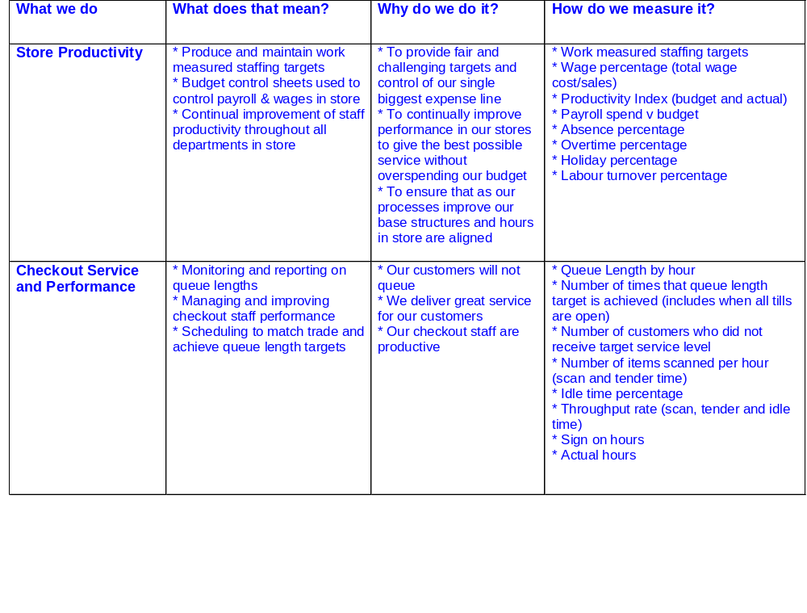
Retail Operations-Capability

Slide 6
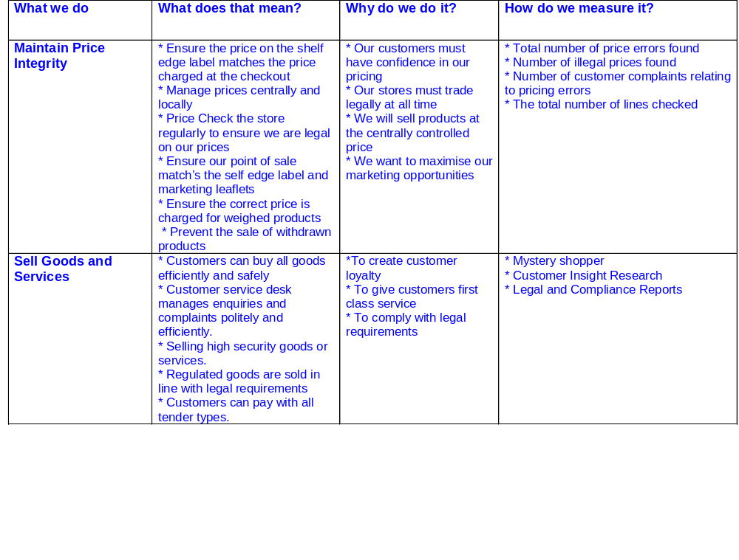
Retail Operations-Capability

Slide 7
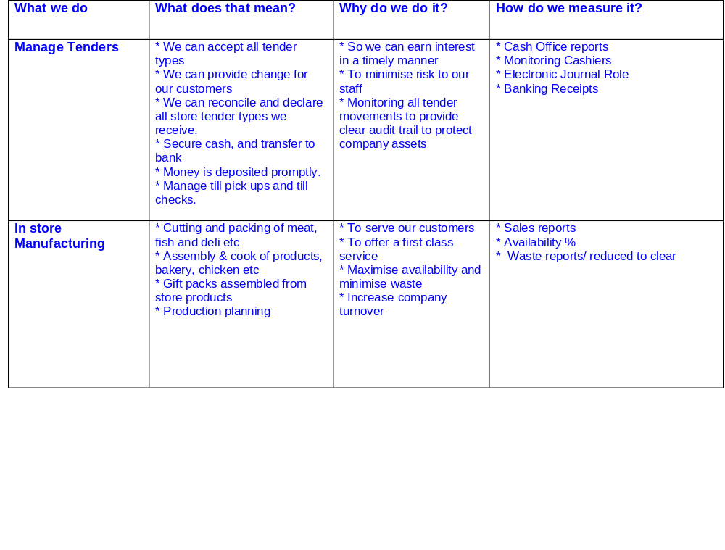
Retail Operations-Capability

Slide 8
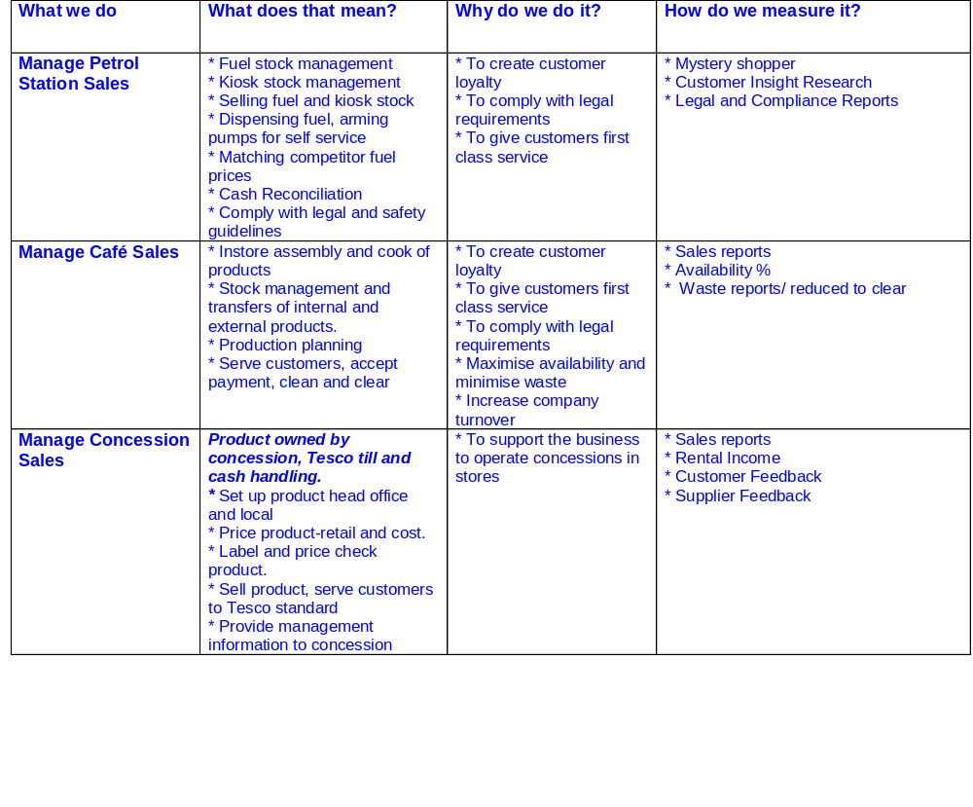
Retail Operations-Capability

Slide 9

Retail Operations-Capability

Slide 10
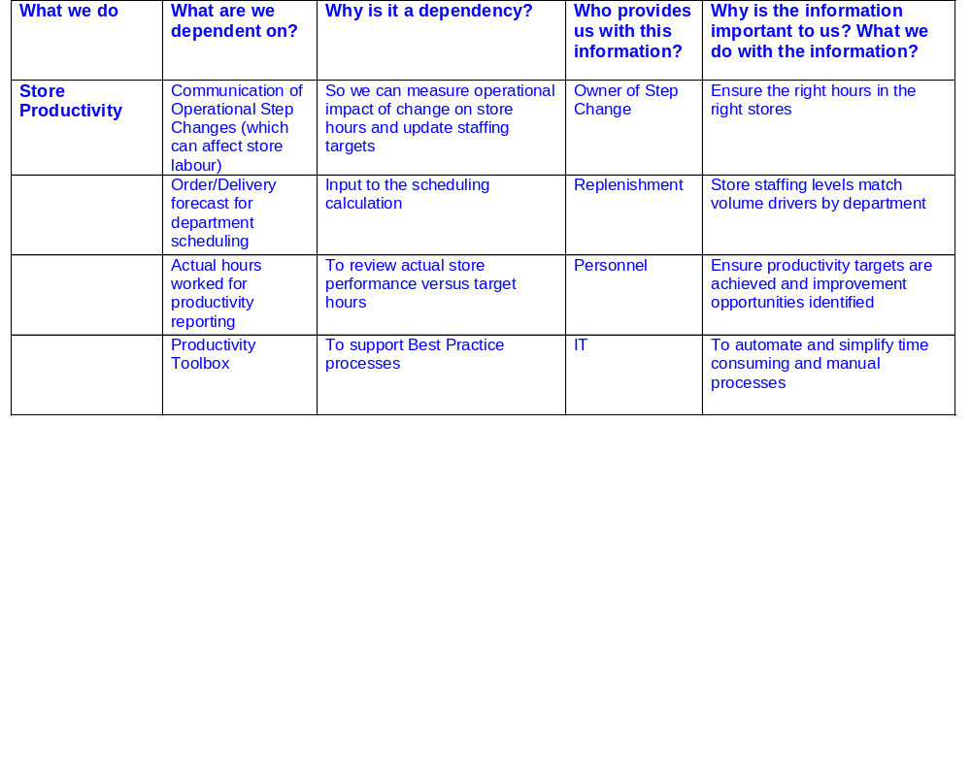
Retail Operations – Key Dependencies

Slide 11
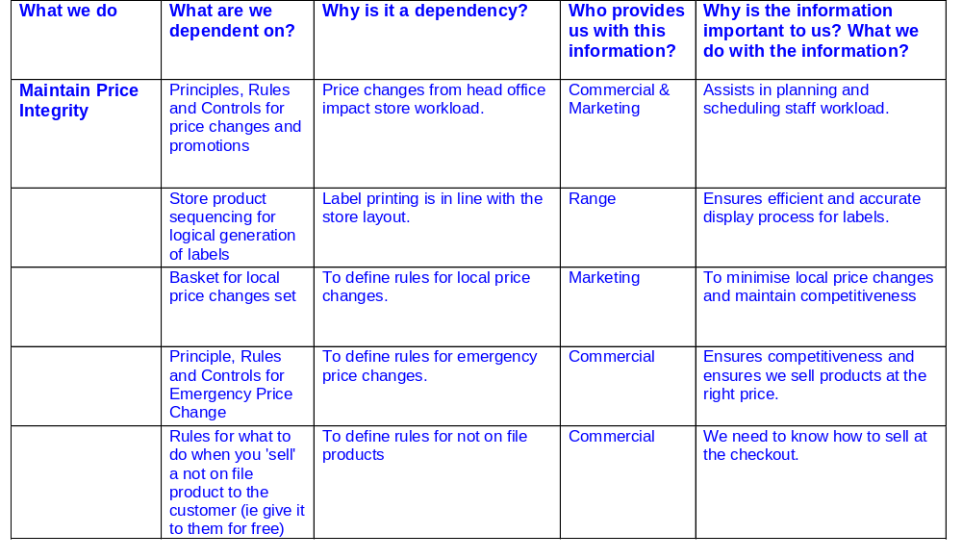
Retail Operations – Key Dependencies

Slide 12
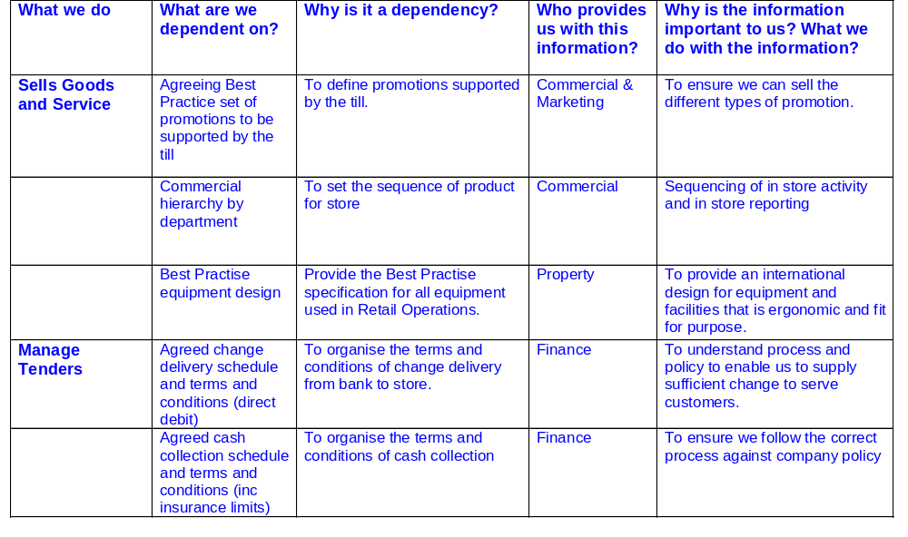
Retail Operations – Key Dependencies

Slide 13
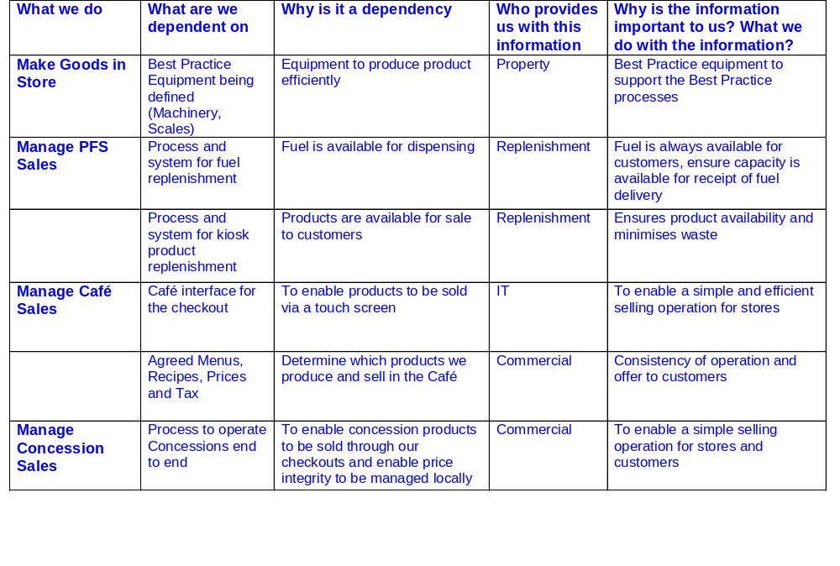
Retail Operations – Key Dependencies

Slide 14
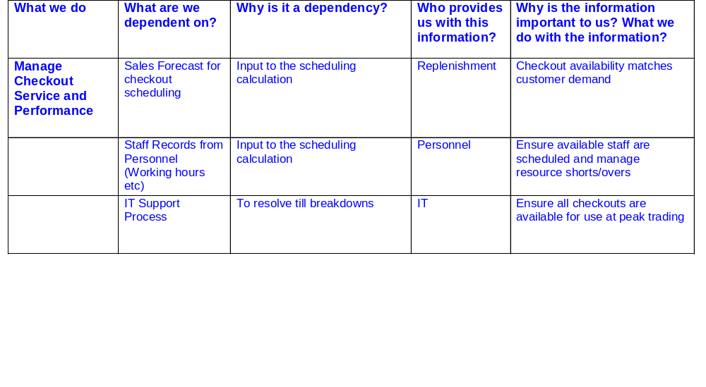
Retail Operations – Key Dependencies

Slide 15
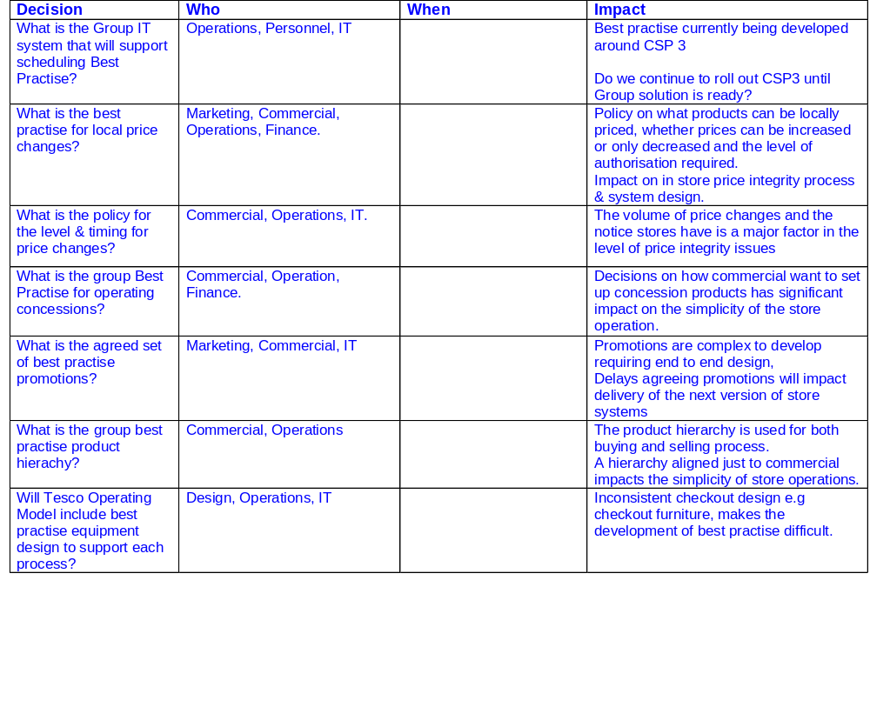
Retail Operations- Key Decisions

Slide 16
Appendix

Slide 17
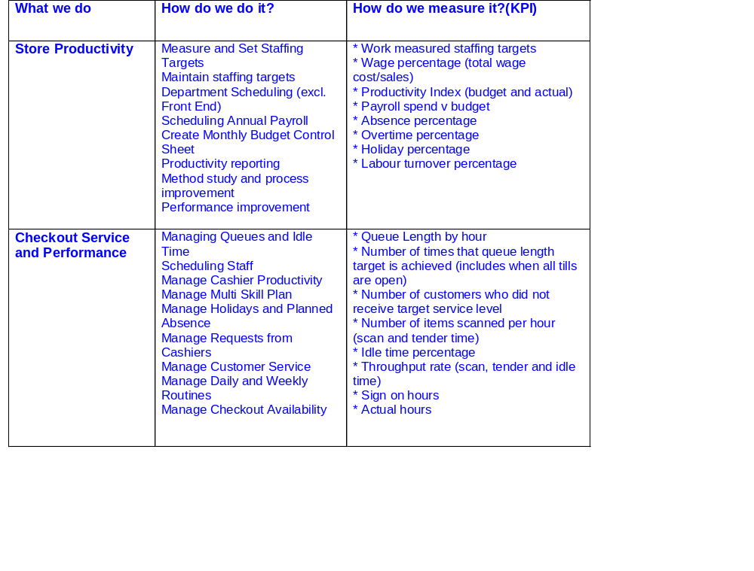
Retail Operations-Capability

Slide 18
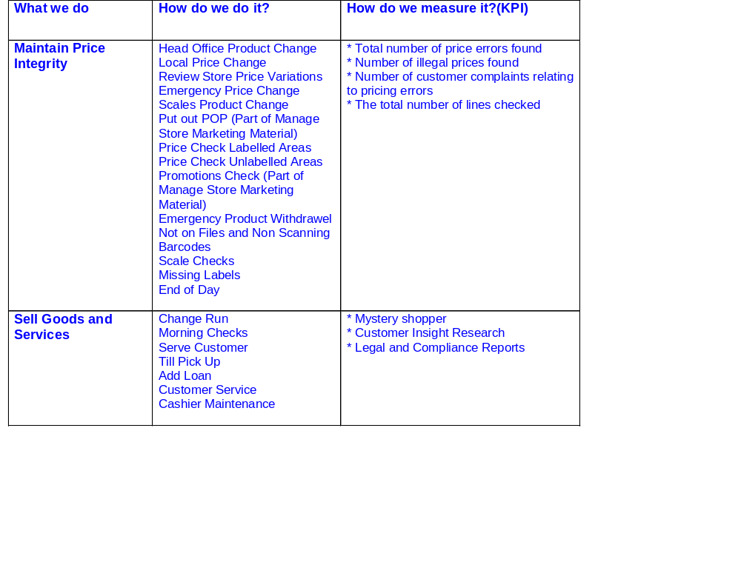
Retail Operations-Capability
Need to agree the number of price changes that can be made on a daily/ weekly basis

Slide 19
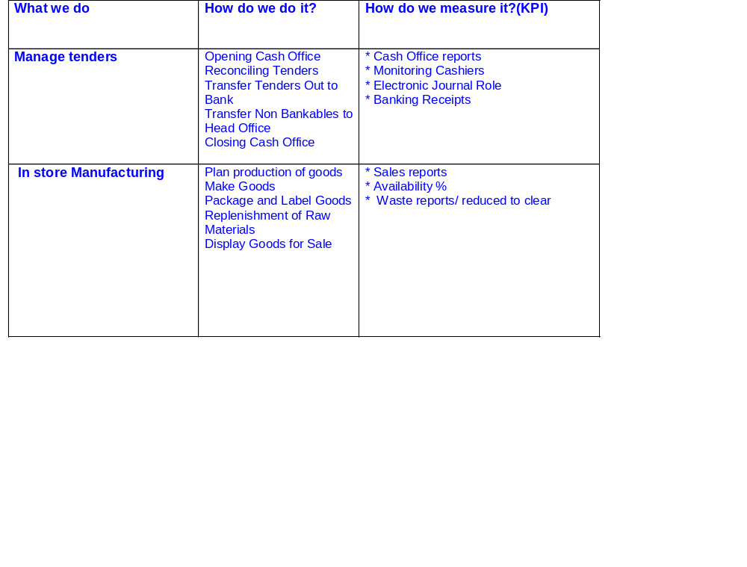
Retail Operations-Capability
Counters are expensive to run and use a lot of space but are important to customers. We want high density, visually attractive offer, differentiated from pre-pack. We have to take pride in our counters but use appropriate space. All counters should have a self serve element to reduce queues and improve sales and trade longer.

Slide 20
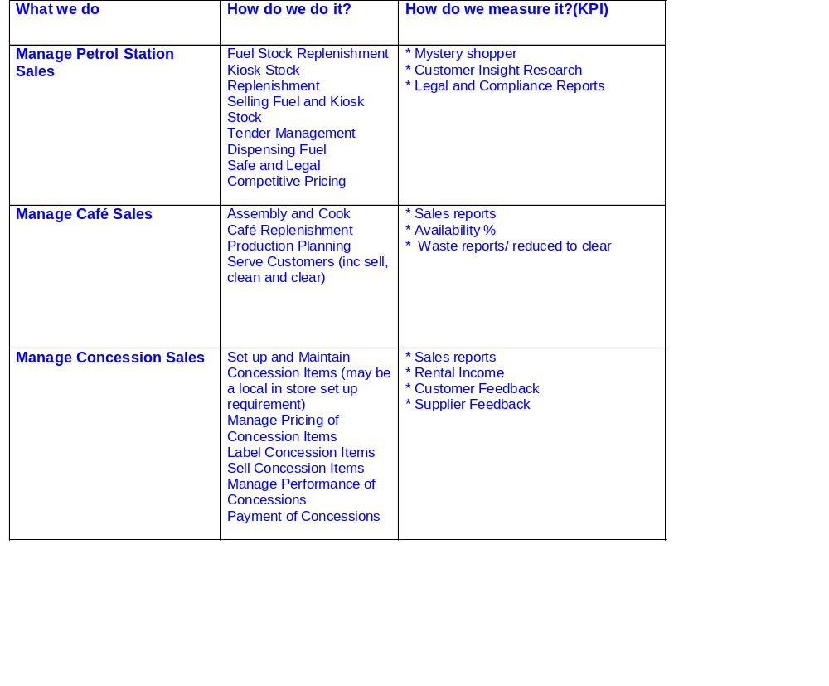
Retail Operations-Capability
We are not good at running cafes in tight space, very marginal

